Slide 1
Macroeconomics ECON 101
Money, Banks, and the Bank of Canada
(Chapter 10)
Instructor: Muhebullah Karimzada
Notes:
If this PowerPoint presentation contains mathematical equations, you may need to check that your computer has the following installed:
1) MathType Plugin
2) Math Player (free versions available)
3) NVDA Reader (free versions available)

Slide 2
Chapter Outline
10.1 What Is Money, and Why Do We Need It?
10.2 How Is Money Measured in Canada Today?
10.3 How Do Banks Create Money?
10.5 The Quantity Theory of Money
Notes:
Long Description:

Slide 3
Money
Money is one of the most important inventions of mankind.
Economists consider money to be any asset that people are generally willing to accept in exchange for goods and services, or for payment of debts.
Asset: Anything of value owned by a person or a firm.
We will begin by considering what role money serves, and what can be used as money.
Then we will consider modern forms of money and the roles of banks and the government in creating and managing money.
Finally, we will create a model that relates prices to the amount of money.

Slide 4
What Is Money, and Why Do We Need It?
10.1 Learning Objective
Define money and discuss the four functions of money.
Suppose you were living before the invention of money.
If you wanted to trade, you would have to barter, trading goods and services directly for other goods and services.
Trades would require a double coincidence of wants.
Eventually, societies started using commodity money—goods used as money that also have value independent of their use as money—like animal skins or precious metals.
The existence of money makes trading much easier and allows specialization, an important step for developing an economy.

Slide 5
The Functions of Money
Money fulfills four primary functions:
Medium of exchange
Money is acceptable to a wide variety of parties as a form of payment for goods and services.
Unit of account
Money allows a way of measuring value in a standard manner.
Store of value
Money allows people to defer consumption till a later date by storing value. Other assets can do this too, but money does it particularly well because it is liquid, easily exchanged for goods.
Standard of deferred payment
Money facilitates exchanges across time when we anticipate that its value in the future will be predictable.

Slide 6
What Can Serve as Money?
In order to serve as an acceptable medium of exchange (and hence a potential “money”), an asset should have the following characteristics:
The asset must be acceptable to most people.
It should be of standardized quality so any two units are alike.
It should be durable so that value is not lost by wearing out.
It should be valuable relative to its weight, so that it can easily be transported even in large quantities.
It should be divisible to be used in purchases of both low-priced and high-priced goods.

Slide 7
Commodity Money
Commodity money has a value independent of its use as money.
Some important historical and modern commodity moneys:
Precious metals, such as gold or silver
Beaver pelts in early settlers of members of an Indigenous group in Canada
Cigarettes in prisons and prisoner-of-war camps

Slide 8
Fiat Money (1 of 2)
In modern economies, paper money is generally issued by a central bank run by the government.
The Bank of Canada is the central bank of Canada. However, money issued by the Bank of Canada is no longer exchangeable for gold; nor is any current world currency. Instead, the Bank of Canada issues currency known as fiat money.
Fiat money refers to any money, such as paper currency, that is authorized by a central bank or governmental body, and that does not have to be exchanged by the central bank for gold or some other commodity money.

Slide 9
Fiat Money (2 of 2)
Fiat money: Money, such as paper currency, that is authorized by a central bank or governmental body and that does not have to be exchanged by the central bank for gold or another commodity money.
It is more flexible for central banks to create money.
However it also creates a potential problem: fiat money is only acceptable as long as households and firms have confidence that if they accept paper dollars in exchange for goods and services, the dollars will not lose much value during the time they hold them.
If people stop “believing” in the fiat money, it will cease to be useful.

Slide 10
How Is Money Measured in Canada Today?
10.2 Learning Objective
Discuss the definitions of the money supply used in Canada today.
The Bank of Canada has conducted several studies to determine the appropriate measure of money in the economy.

Slide 11
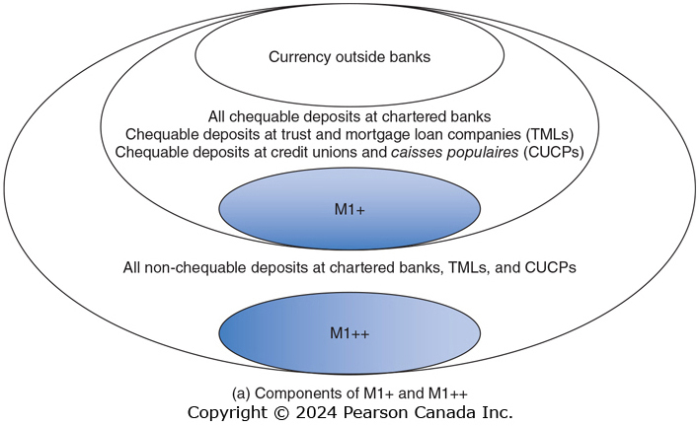
Figure 10.1 Components of the Money Supply (1 of 3)
M1+ is the narrowest definition of money it includes:
Currency in circulation
Chequable deposits at banks, trust and mortgage companies, credit unions and caisses populaires.
M1++ includes M1+ and non-chequable deposits
The Bank of Canada uses six different definitions of the money supply: M1+, M1++, M2, M2+, M2++, and M3. M1+ is the narrowest definition of the money supply and M2++ is the broadest.

Slide 12
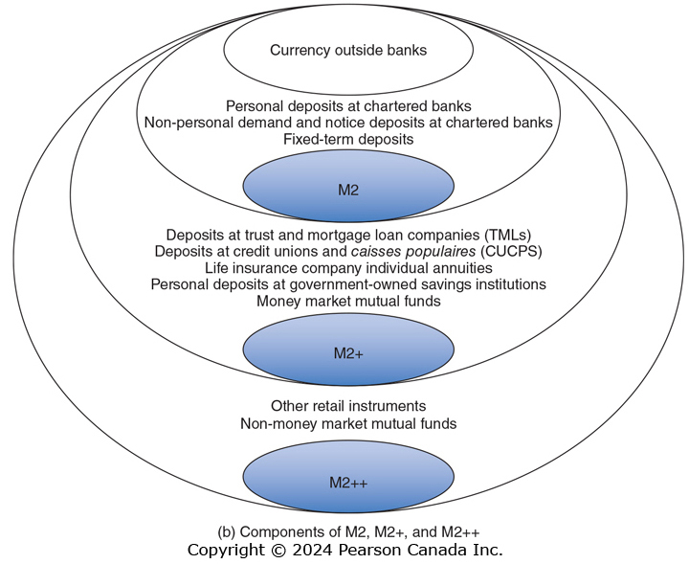
Figure 10.1 Components of the Money Supply (2 of 3)
M2 includes
Currency
personal deposits at banks
non-personal demand and notice deposits at banks
fixed term deposits.
M2++ includes (broadest definition) M2+
Canada Savings Bonds
Non-money market mutual funds.
M2+ includes M2 and
Deposits at TMLs and CUCPs
life insurance companies individual annuities
Government owned savings institutions
Money market mutual funds.

Slide 13
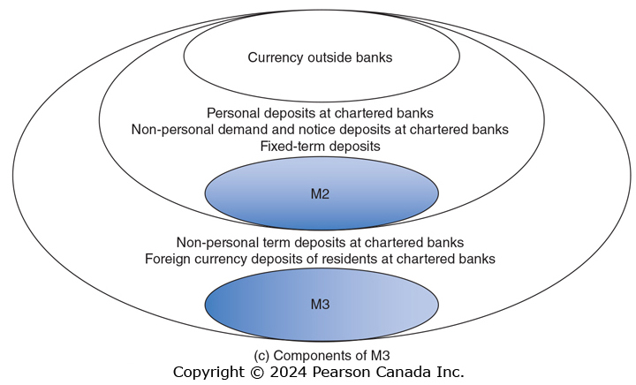
Figure 10.1 Components of the Money Supply (3 of 3)
M3 includes
M2
Non-personal term deposits at banks
Foreign currencies deposits of Canadians at banks

Slide 14
Which Definition?
When we want to talk about the money supply, which definition should we use?
Any one of the three might be valid, but we are mostly interested in money’s role as the medium of exchange, so this suggests using M1+.
In our discussion of money, we will therefore:
Treat both currency and chequing and non-chequing account balances as “money”, but nothing else.
Realize that banks play an important role in the money supply, since they control what happens to money when it is in an account.

Slide 15
How Do Banks Create Money?
10.3 Learning Objective
Explain how banks create money.
Banks play a critical role in the money supply.
Recall that there is more money held in checking accounts than there is actual currency in the economy.
So money is being created by banks.
Further, banks are profit-making private firms: among the largest corporations in the country.
Their activities are designed to allow themselves to make a profit.
In order to understand the role that banks play, we will first try to understand how banks operate as a business.

Slide 16
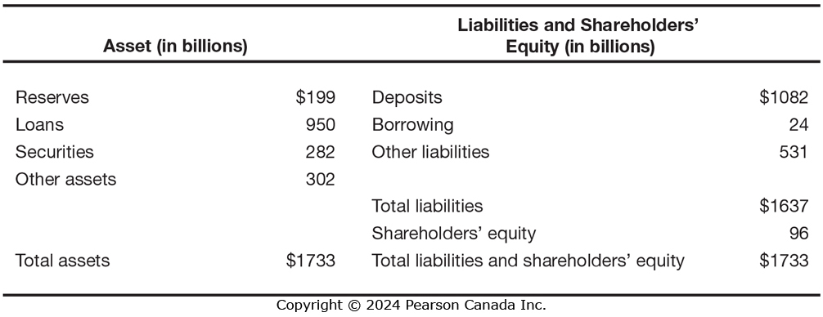
Figure 10.2 Balance Sheet for Royal Bank, September 30, 2021 (1 of 2)
SOURCE: http://www.osfi-bsif.gc.ca/Eng/Pages/default.aspx (accessed on December 9, 2021).
On a balance sheet, a firm’s assets are listed on the left, and its liabilities (and stockholders’ equity, or net worth) are listed on the right. The left and right sides must add to the same amount.
Banks use money deposited with them to make loans and buy securities (investments).
Their largest liabilities are their deposit accounts: money they owe to their depositors.

Slide 17
Figure 10.2 Balance Sheet for Royal Bank, September 30, 2021 (2 of 2)
SOURCE: http://www.osfi-bsif.gc.ca/Eng/Pages/default.aspx (accessed on December 9, 2021).
Reserves are deposits that a bank keeps as cash in its vault or on deposit with the Bank of Canada.
Notice that the bank does not keep enough deposits on hand to cover all of its deposits. This is a big part of how the bank makes a profit: lending out or investing money deposited with it.

Slide 18
Required and Excess Reserves
The bank must keep some cash available for its depositors; it does this through a combination of vault cash and deposits with the Bank of Canada.
These funds are reserves: deposits that a bank keeps on hand to meet customers’ withdrawals needs.
Banks in Canada are NOT required to hold a specific level of reserves.
Banks desire to keep a fraction of their deposits (about 5 percent) on hand as reserves.
This 5% is known as the desired reserve ratio (r_{d}): the fraction of deposits banks want to keep as reserves.
Banks might increase their desired reserve ratio or reduce it depending on the state of the economy or state of financial markets.

Slide 19
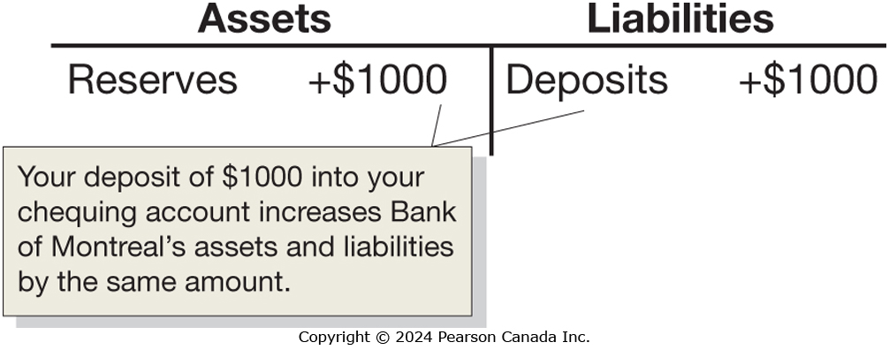
Using T-Accounts to Show Money Creation
A T-account is a stripped-down version of a balance sheet, showing only how a transaction changes a bank’s balance sheet.
When you deposit $1,000 in currency at Bank of Montreal (BMO), its reserves increase by $1,000 and so do its deposits:
The currency component of the money supply decreases by the $1,000, since that $1,000 is no longer in circulation; but the checking deposits component increases by $1,000. So there is no net change in the money supply—yet.
Notes:
Long Description:
A comment box pointing to $1000 of reserves and deposits of reads your deposit of $1000 into your chequing account increases bank of Montreal’s assets and liabilities by the same amount.

Slide 20
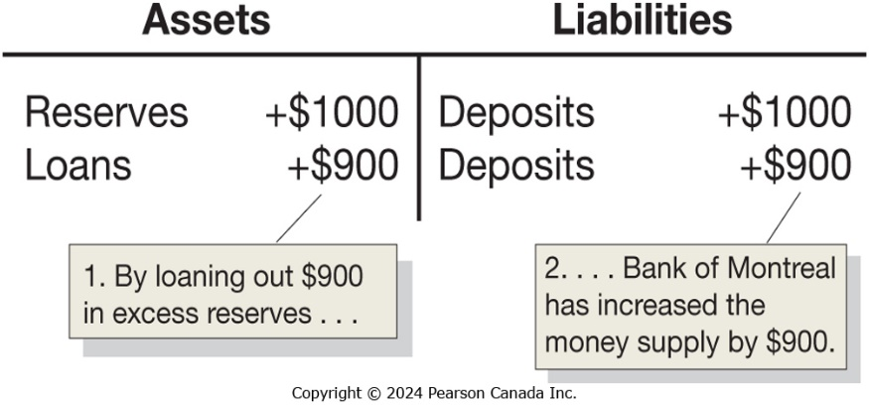
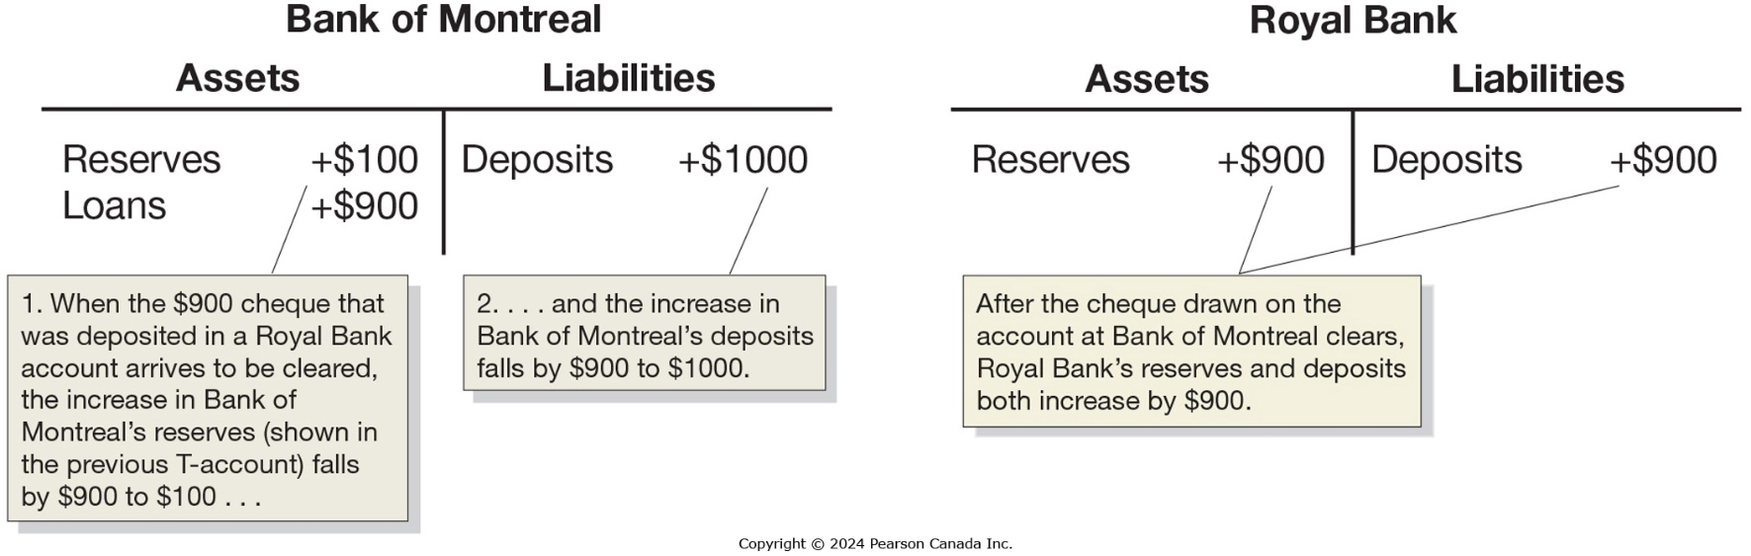
T-Accounts
But BMO needs to make a profit; so it keeps 10% (for example) of the deposit as reserves, and lends out the rest, creating a $900 checking account deposit.
The $900 initially appears in a BMO checking account but will soon be spent; and BMO will transfer $900 in currency to the bank at which the $900 check is deposited.
Notes:
Long Description:
A comment box pointing at the amount of assets reads when the $900 cheque that was deposited in a Royal Bank account arrives to be cleared, the increase in Bank of Montreal's reserves left parenthesis shown in the previous T-account right parenthesis falls by $900, to $100 ellipses. Another comment box pointing at the amount of deposits reads the increase in the bank of Montreal’s deposits falls by $900 to $1000.
The assets are reserves of $1000 and loans of $900, and liabilities are deposits of $1000 and $900. A comment box pointing at the loan of $900 reads that by loaning out $900 in excess reserves, and another comment box pointing at deposits of $900 reads the bank of Montreal has increased the money supply by $900.
A comment box pointing $900 of reserves and deposits of $900 reads after the cheque drawn on the account at Bank of Montreal clears Royal Bank's reserves and deposits both increase by $900.

Slide 21
When Will It End?
Each “round”, the additional checking account deposits get smaller and smaller.
Every round, 10% of the deposits are kept as reserves. This allows us to tell by how much the checking deposits will eventually increase: the $1,000 in currency will become the 10% required reserves for all of the checking deposits, so a total of $10,000 in checking deposits can be created.
Bank | Increase in Chequing Account Deposit
Bank of Montreal | $1000
Royal Bank | + 900 (= 0.9 × $1000)
Third Bank | + 810 (= 0.9 × $ 900)
Fourth Bank | + 729 (= 0.9 × $ 810)
• | + •
• | + •
• | + •
Total change in chequing account deposits | = $10 000

Slide 22
Simple Deposit Multiplier
An alternative way to find out how much money the original $1,000 in currency will create is to add up all of the checking account deposits.
The expression in the parentheses can be rewritten as:
So the total increase in deposits is $1,000(10) = $10,000.
The “10” here is the simple deposit multiplier: the ratio of the amount of deposits created by banks to the amount of new reserves.

Slide 23
General Form for the Simple Deposit Multiplier
In general, we can write the simple deposit multiplier as:
So with a 10% desired required reserve ratio (r_{d}), the simple deposit multiplier is 10.
With a 20% desired required reserve ratio, the simple deposit multiplier is 5.
For example, $100,000 in new deposit, with a 10% desired reserve ratio, results in:

Slide 24
The Simple Deposit Multiplier vs Real-World Deposit Multiplier
With a 10% desired reserve ratio, the simple deposit multiplier tells us that a currency deposit will be multiplied 10 times.
But in reality, we do not observe this.
Why this difference?
Banks may not lend out as much as we predict, either because they want to keep excess reserves, or they cannot find credit-worthy borrowers.
Consumers keep some currency out of the bank; that currency cannot be used as required reserves.
Note: during the financial crisis of 2007–2009, research suggests that the real-world multiplier fell to close to 1 in the US.

Slide 25
Conclusions About Banks and the Money Supply
In general, we can assume that the real-world deposit multiplier is greater than 1. So we conclude that:
When banks gain reserves, they make new loans, and the money supply expands.
When banks lose reserves, they reduce their loans, and the money supply contracts.
This is enough to establish the important relationship between banks and the money supply.

Slide 26
The Quantity Theory of Money
10.5 Learning Objective
Explain the quantity theory of money and use it to explain how high rates of inflation occur.
Beginning in the 16th century, Spain sent gold and silver from Mexico and Peru back to Spain.
These metals were minted into coins, increasing the money supply.
Prices in Europe rose steadily during those years.
This helped observers make the connection between inflation and the flow of gold and silver into Europe from the Americas.

Slide 27
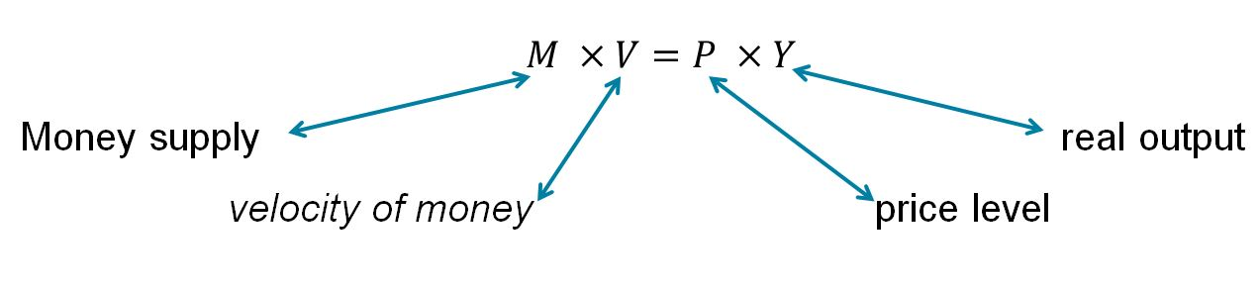
The Quantity Equation
In the early 20th century, Irving Fisher formalized the relationship between money and prices by using the quantity equation:
Velocity of money: the average number of times per year each dollar in the money supply is used to purchase goods and services included in GDP.
Rewriting this equation by dividing through by M, we obtain:

Slide 28
Calculating the Velocity of Money
Measuring:
The money supply (M) with M1+,
The price level (P) with the GDP deflator, and
The level of real output (Y) with real GDP,
We obtain the following value for velocity (V) in 2021:
We can always calculate V. But will we always get the same answer?
The quantity theory of money is a theory about the connection between money and prices that assumes that the velocity of money is constant.

Slide 29
The Quantity Theory Explanation of Inflation
When variables are multiplied together in an equation, we can form the same equation with their growth rates added together.
So the quantity equation:
generates:
We can rewrite the equation to help understand what determines inflation by assuming that velocity of money is constant, we obtain:

Slide 30
The Inflation Rate According to the Quantity Theory
This equation provides the following predictions:
If the money supply grows faster than real GDP, there will be inflation.
If the money supply grows slower than real GDP, there will be deflation (a decline in the price level).
If the money supply grows at the same rate as real GDP, there will be neither inflation nor deflation: the price level will be stable.
Is velocity truly constant from year to year? The answer is no.
But the quantity theory of money can still provide insight:
In the long run, inflation results from the money supply growing at a faster rate than real GDP.

Slide 31
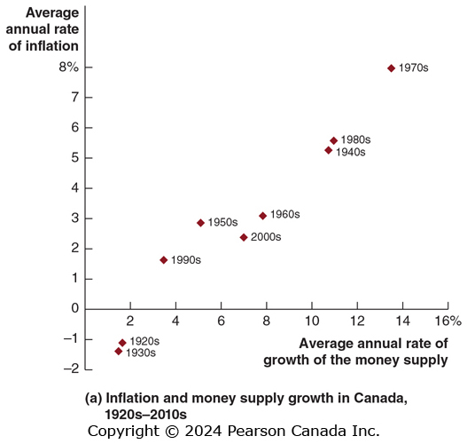
Figure 10.7 The Relationship between Money Growth and Inflation over Time and around the World (1 of 2)
Real GDP growth has been relatively consistent over time.
So based on the quantity theory of money (QTM), there should be a predictable, positive relationship between the annual rates of inflation and growth rates of the money supply.
There is a positive relationship, more stronger in the long run.
SOURCES: Panel (a): Data for 1870 to 1960, M. C. Urquhart, “Canadian Economic Growth 1870–1985,” Institute for Economic Research, Queens University, Kingston, Ontario, Discussion Paper No. 734; and since 1961, Statistics Canada, CANSIM II series V3860248 and V41552796

Slide 32
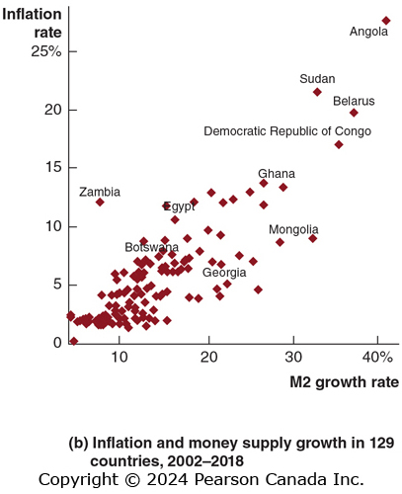
Figure 10.7 The Relationship between Money Growth and Inflation over Time and around the World (2 of 2)
We see a similar story when we compare average rates of inflation and growth rates of the money supply across different countries.
Although the relationship is not entirely predictable, countries with higher growth in the money supply do have higher rates of inflation.
SOURCES: Panel (b): International Monetary Fund, Money and Financial Statistics.
Notes:
.

Slide 33
High Rates of Inflation
Very high rates of inflation—in excess of 50 percent per month—are known as hyperinflation.
Hyperinflation results when central banks increase the money supply at a rate far in excess of the growth rate of real GDP.
This might happen when governments want to spend much more than they raise through taxes, so they force their central bank to “buy” government bonds.
Recently, hyperinflation has occurred in Zimbabwe; the inflation rate became high enough, people stop using paper currency.
Hyperinflation tends to be associated with slow growth, if not severe recession.

